Slide 1
Intro to Arduino
Notes:
Input output digital analog and a little programming

Slide 2

Teachers
Teacher 1
Teacher 2
Notes:
Introduce instructors

Slide 3
Class
Goals today
Write first programs to see how easy it is
What is Arduino?
Blink an LED
Use a button
Control a servo
Connect to Arduino Resources
Notes:
Overview of what will be covered. This is designed to be 90 minutes which isn’t a lot of time but what we’re hoping to gain is confidence that you can find a project and pickup and run with it without being intimidated. These 3 functions cover a very large percentage of what you’ll be doing with an Arduino on any project. We’ll also cover further Arduino resources.

Slide 4
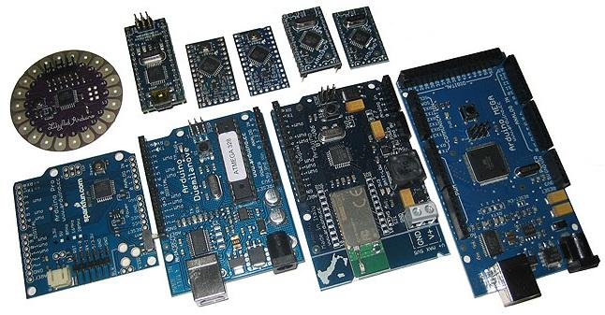
What's Arduino
Microcontroller built around Atmel chip
Started 2005
Open Source
Strong friend
Notes:
Microcontroller Invented in 2005
Strong friend in Italian
Open source
5x better than moon shuttle
Atmega 328 chip
Coding is accessible and tranferable C++,processing, drag and drop for kids

Slide 5
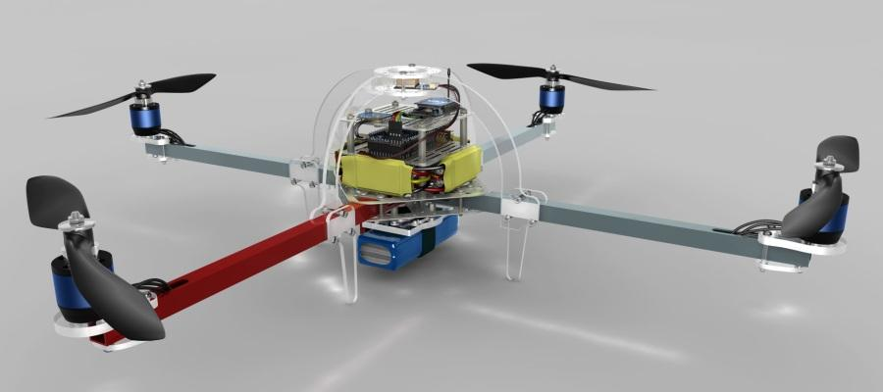
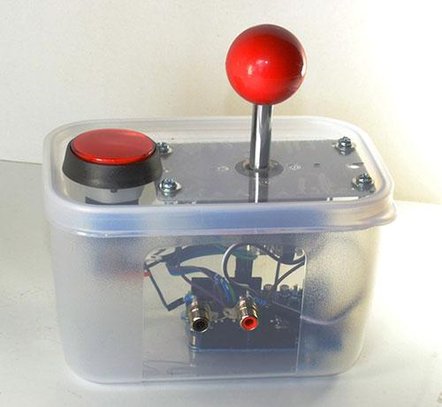
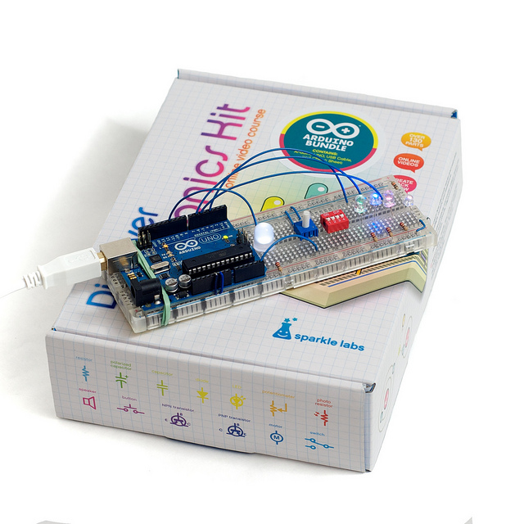

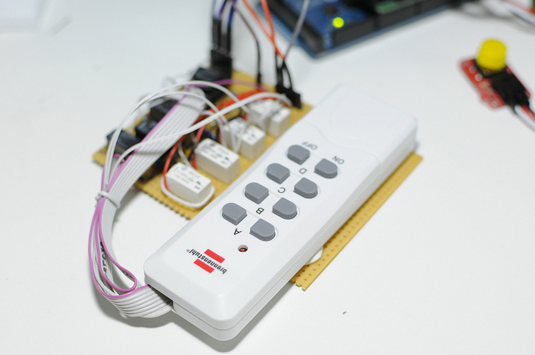
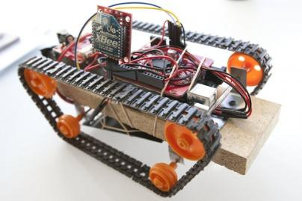
What is it good for
Easy for artists, kids, and prototyping
Photo credits; ArduCopter, APCMag, SparkleLabs, Adafruit, unknown, ProjectAllusion

Slide 6
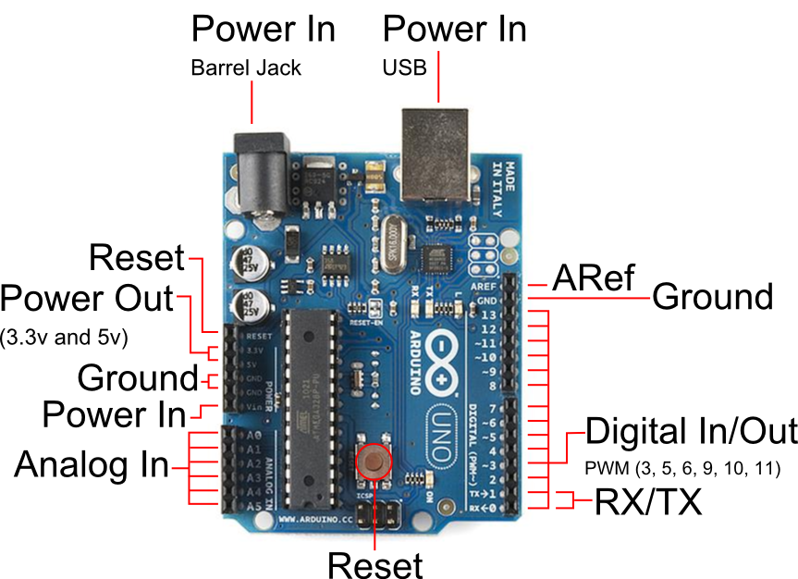
Board layout
Illustration Credit; arduinomatic.com
Notes:
7-12V wall wart or battery (9v works well)
16Mhz
32k memory
14 digital pins 6 analog pins

Slide 7
Arduino Software
www.arduino.cc for IDE and drivers
Cross platform Windows, Mac, Linux, mobile
Plug it in, Open “Arduino” from the Desktop
Double check Tools menu > Board
and Tools menu > Serial Port

Slide 8
Examples
Arduino IDE
Files > Examples
www.arduino.cc
Learning > Examples

Slide 9
Blink on board LED
File > Examples > Basics > Blink
File > Upload
Shows that your board is working
Is there a quicker way to Upload?
Notes:
Known good
How fast can you blink it and still see it
Wave it, persistance of vision
peripheral vision
Long short Long short, heartbeat
Brackets are like the bun
Programming is write, test, write, test

Slide 10
Blink an off board LED
Arduino.cc > Learning > Examples > Blink shows the wiring diagram (ignore resistor)
Figure out how to change the blink rate or add a heartbeat
What would you share with other beginners?

Slide 11
Use a button
Arduino.cc Learning > Examples > Digital > Input Pullup Serial
IDE > File > Examples > Digital > DigitalInputPullup
What can you learn from the code? Invert the button press or find the Serial Monitor

Slide 12
Servo
learn.adafruit.com > search “arduino servo” > Lesson 14 > Breadboard layout for sweep and Arduino Code for Sweep
Wire colors are likely wrong Red is power, black/brown is ground, else

Slide 13
More Resources
How Arduino is Open Source Imagination
Adafruit learn Arduino
Tutorial Series for Arduino Videos
Make Magazine
Duluth MakerSpace

Slide 14
Your MakerSpace info
$25/month membership
Access to tools and people during open hours
Member meetings Sunday’s at 6pm
Free meetings Wednesday evenings
3D printed gift certificates available
Notes:
Sell the MakerSpace and why students would want to become members.

Slide 15

MIT Licence
Permits reuse with attribution
http://opensource.org/licenses/MIT
Original presentation by:

